Slide 1


Capstone Project Bike SHARING DEMAND Prediction (Supervised Machine Learning Regression)
Team Member:-
1) Kuresh Chandra Tripathy
2) N Santosh Kumar Choudhury

Slide 2
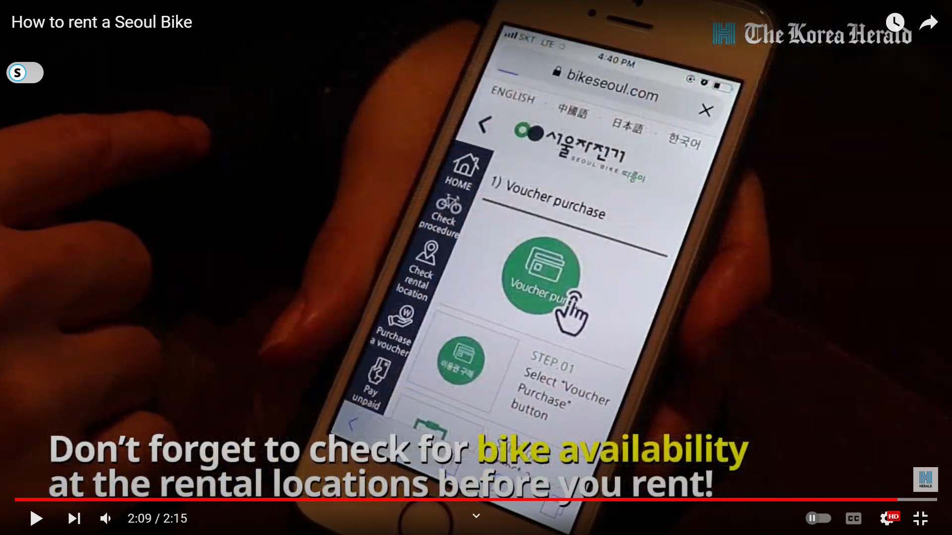

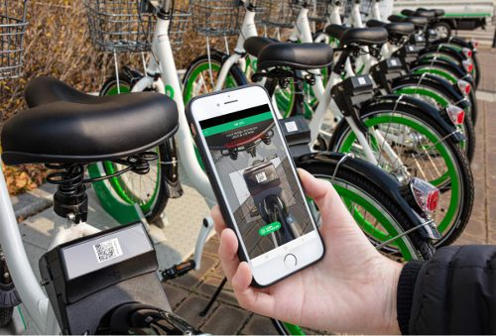
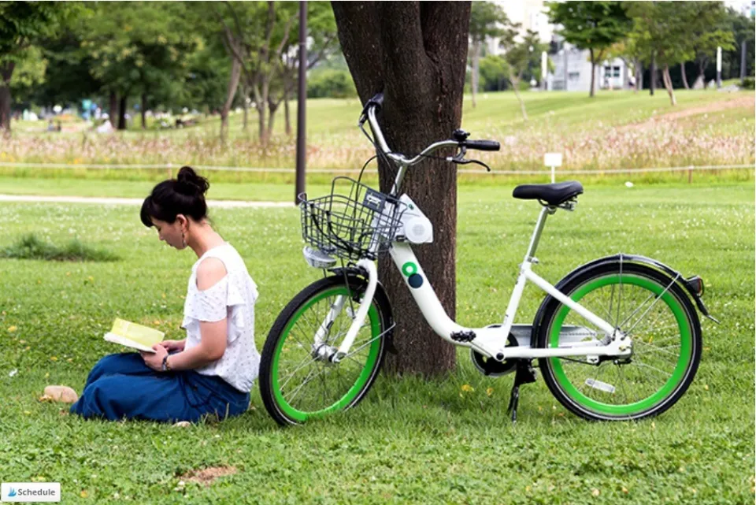
Points to Discuss:-
Agenda
Problem Statement
Workflow
Data Collection and Understanding
Data Wrangling & Feature Engineering
EDA
Preparation of data for model building. Some important questions
Model Selection and Evaluation
Conclusion

Slide 3
Agenda:-
To discuss the analysis of given prediction of bike count required at each hour for the stable supply of rental bikes.
We’ll be doing analysis of given data set in the following ways:-
Problem statement
Data Collection and Understating
Data Wrangling & Feature Engineering
EDA
Preparation of data for model building.
Model Selection and Evaluation
Conclusions

Slide 4
Problem Statement:-
Currently Rental bikes are introduced in many urban cities for the enhancement of mobility comfort.
It is important to make the rental bike available and accessible to the public at the right time as it lessens the waiting time. Eventually, providing the city with a stable supply of rental bikes becomes a major concern.
The crucial part is the prediction of bike count required at each hour for the stable supply of rental bike.
The final aim of this project is the prediction of bike count required at each hour for the stable supply of rental bikes by using suitable regression model.

Slide 5
Workflow:-
Data Collection and Understanding
Data Wrangling & Feature Engineering
EDA
Preparation of data for model building.
Model Selection and Evaluation
Conclusions

Slide 6
Data Collection and Understating:-
In the above Dataset we have given Seoul bike Data for our analysis and model building. There are 14 number of features, and 8760 observations are given in the SeoulBikeData.csv file.
The dataset generally contain target/dependent variable “Ranted bike count” and independent variable like weather information, and date information.
Date : year-month-day
Rented Bike count - Count of bikes rented at each hour
Hour - Hour of the day
Temperature-Temperature in Celsius
Humidity - %
Windspeed - m/s
Visibility - 10m
Dew point temperature - Celsius
Solar radiation - MJ/m2
Rainfall - mm
Snowfall - cm
Seasons - Winter, Spring, Summer, Autumn
Holiday - Holiday/No holiday
Functional Day – NoFunc (Non-Functional Hours), Fun(Functional hours)

Slide 7
Data Wrangling and Feature Engineering:-

Slide 8
Data Collection and Understating:-

